Slide 1
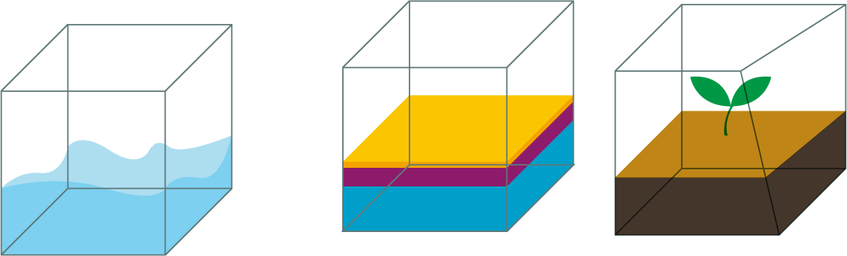
AAI. Seminar
국민청원 분류 - TextCNN
2021.11.03
김 민 준

Slide 2

CONTENTS
CHAPTER 1
CHAPTER 2
CNN
Task
CHAPTER 3
CHAPTER 4
TextCNN
CODE

Slide 3
CHAPTER 1
CNN
What is CNN(Convolution Neural Network)?
이미지 인식 – 패턴 학습에 특화된 신경망
Convolution 연산을 통한 연산
부분을 보는 것이 핵심 아이디어
(부분 : Filter)
Fully-Connected Layer에 비해 매우 빠르고 적은 파라미터를 가짐.

Slide 4

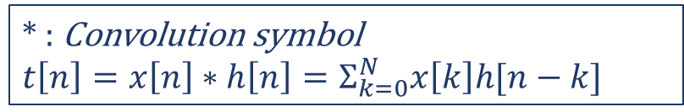

CHAPTER 1
CNN
* : Convolution symbol
$t\left[n\right]=x\left[n\right]∗h\left[n\right]=Σ_{k=0}^{N}x\left[k\right]h[n−k]$
What is Convolution ?
input
filter
Output
(feature map)
$$⨂$$
$$=$$

Slide 5
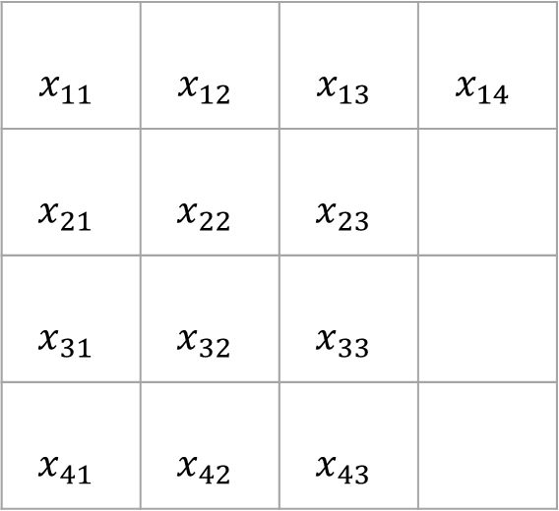
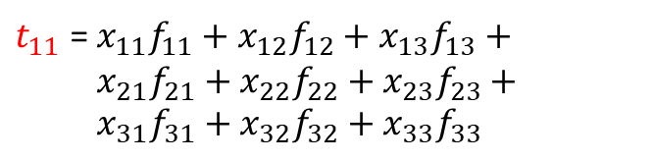
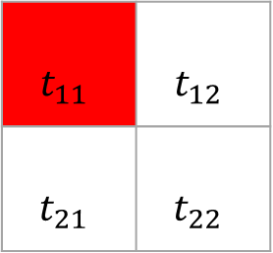
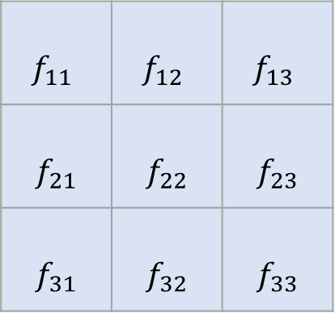
CHAPTER 1
CNN
* : Convolution symbol
$t\left[n\right]=x\left[n\right]∗h\left[n\right]=Σ_{k=0}^{N}x\left[k\right]h[n−k]$
Convolution Operation
$t_{11}$ = $x_{11}f_{11}+x_{12}f_{12}+x_{13}f_{13}+ x_{21}f_{21}+x_{22}f_{22}+x_{23}f_{23}+ x_{31}f_{31}+x_{32}f_{32}+x_{33}f_{33}$
input
$$x_{11}$$ | $$x_{12}$$ | $$x_{13}$$ | $$x_{14}$$
$$x_{21}$$ | $$x_{22}$$ | $$x_{23}$$
$$x_{31}$$ | $$x_{32}$$ | $$x_{33}$$
$$x_{41}$$ | $$x_{42}$$ | $$x_{43}$$
filter
$$f_{11}$$ | $$f_{12}$$ | $$f_{13}$$
$$f_{21}$$ | $$f_{22}$$ | $$f_{23}$$
$$f_{31}$$ | $$f_{32}$$ | $$f_{33}$$
output
$$t_{11}$$ | $$t_{12}$$
$$t_{21}$$ | $$t_{22}$$

Slide 6
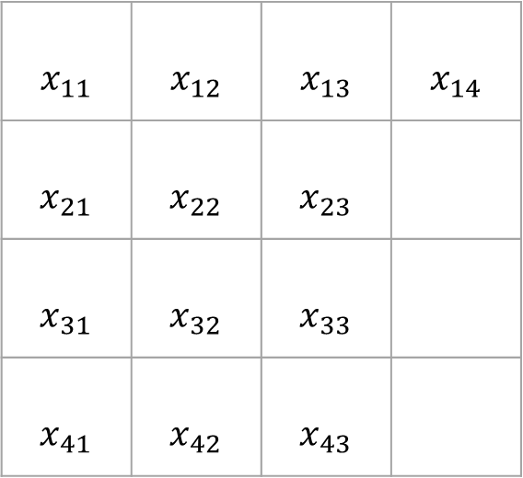
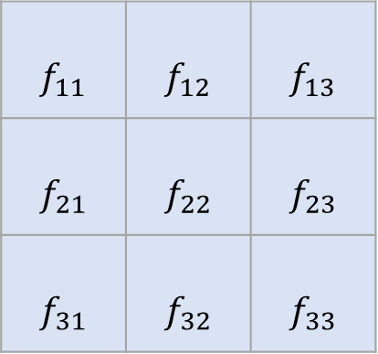

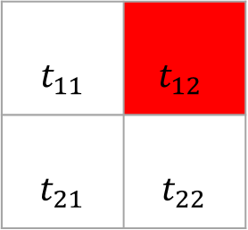
CHAPTER 1
CNN
* : Convolution symbol
$t\left[n\right]=x\left[n\right]∗h\left[n\right]=Σ_{k=0}^{N}x\left[k\right]h[n−k]$
Convolution Operation
$t_{12}$ = $x_{12}f_{11}+x_{13}f_{12}+x_{14}f_{13}+$
$x_{22}f_{21}+x_{23}f_{22}+x_{24}f_{23}+ x_{32}f_{31}+x_{33}f_{32}+x_{34}f_{33}$
input
$$x_{11}$$ | $$x_{12}$$ | $$x_{13}$$ | $$x_{14}$$
$$x_{21}$$ | $$x_{22}$$ | $$x_{23}$$
$$x_{31}$$ | $$x_{32}$$ | $$x_{33}$$
$$x_{41}$$ | $$x_{42}$$ | $$x_{43}$$
filter
$$f_{11}$$ | $$f_{12}$$ | $$f_{13}$$
$$f_{21}$$ | $$f_{22}$$ | $$f_{23}$$
$$f_{31}$$ | $$f_{32}$$ | $$f_{33}$$
output
$$t_{11}$$ | $$t_{12}$$
$$t_{21}$$ | $$t_{22}$$

Slide 7
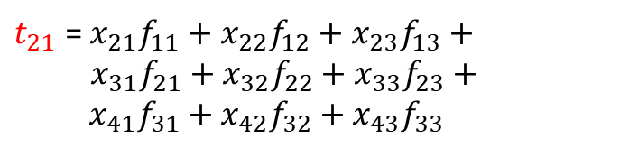
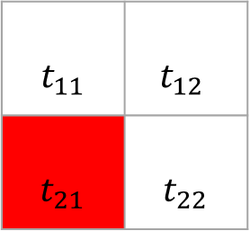
CHAPTER 1
CNN
* : Convolution symbol
$t\left[n\right]=x\left[n\right]∗h\left[n\right]=Σ_{k=0}^{N}x\left[k\right]h[n−k]$
Convolution Operation
$t_{21}$ = $x_{21}f_{11}+x_{22}f_{12}+x_{23}f_{13}+$
$x_{31}f_{21}+x_{32}f_{22}+x_{33}f_{23}+ x_{41}f_{31}+x_{42}f_{32}+x_{43}f_{33}$
input
$$x_{11}$$ | $$x_{12}$$ | $$x_{13}$$ | $$x_{14}$$
$$x_{21}$$ | $$x_{22}$$ | $$x_{23}$$
$$x_{31}$$ | $$x_{32}$$ | $$x_{33}$$
$$x_{41}$$ | $$x_{42}$$ | $$x_{43}$$
filter
$$f_{11}$$ | $$f_{12}$$ | $$f_{13}$$
$$f_{21}$$ | $$f_{22}$$ | $$f_{23}$$
$$f_{31}$$ | $$f_{32}$$ | $$f_{33}$$
output
$$t_{11}$$ | $$t_{12}$$
$$t_{21}$$ | $$t_{22}$$

Slide 8
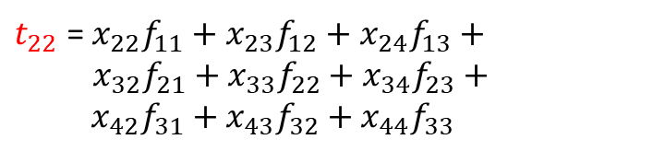
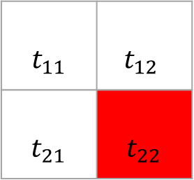
CHAPTER 1
CNN
* : Convolution symbol
$t\left[n\right]=x\left[n\right]∗h\left[n\right]=Σ_{k=0}^{N}x\left[k\right]h[n−k]$
Convolution Operation
$t_{22}$ = $x_{22}f_{11}+x_{23}f_{12}+x_{24}f_{13}+$
$x_{32}f_{21}+x_{33}f_{22}+x_{34}f_{23}+ x_{42}f_{31}+x_{43}f_{32}+x_{44}f_{33}$
input
$$x_{11}$$ | $$x_{12}$$ | $$x_{13}$$ | $$x_{14}$$
$$x_{21}$$ | $$x_{22}$$ | $$x_{23}$$
$$x_{31}$$ | $$x_{32}$$ | $$x_{33}$$
$$x_{41}$$ | $$x_{42}$$ | $$x_{43}$$
filter
$$f_{11}$$ | $$f_{12}$$ | $$f_{13}$$
$$f_{21}$$ | $$f_{22}$$ | $$f_{23}$$
$$f_{31}$$ | $$f_{32}$$ | $$f_{33}$$
output
$$t_{11}$$ | $$t_{12}$$
$$t_{21}$$ | $$t_{22}$$

Slide 9
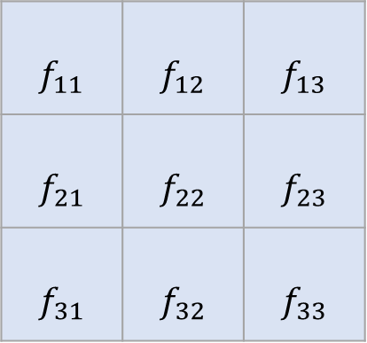
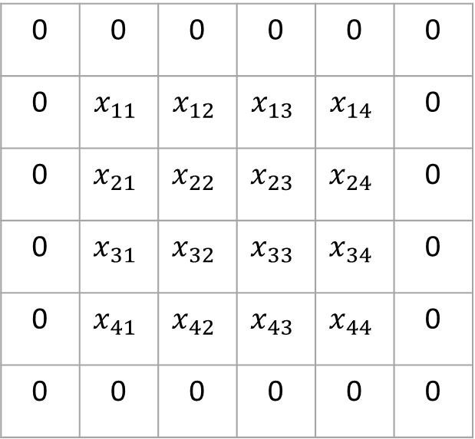
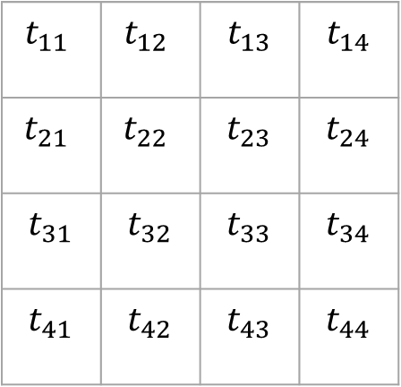

CHAPTER 1
CNN
padding?
input
0 | 0 | 0 | 0 | 0 | 0
0 | $$x_{11}$$ | $$x_{12}$$ | $$x_{13}$$ | $$x_{14}$$ | 0
0 | $$x_{21}$$ | $$x_{22}$$ | $$x_{23}$$ | $$x_{24}$$ | 0
0 | $$x_{31}$$ | $$x_{32}$$ | $$x_{33}$$ | $$x_{34}$$ | 0
0 | $$x_{41}$$ | $$x_{42}$$ | $$x_{43}$$ | $$x_{44}$$ | 0
0 | 0 | 0 | 0 | 0 | 0
output
filter
$$f_{11}$$ | $$f_{12}$$ | $$f_{13}$$
$$f_{21}$$ | $$f_{22}$$ | $$f_{23}$$
$$f_{31}$$ | $$f_{32}$$ | $$f_{33}$$
$$t_{11}$$ | $$t_{12}$$ | $$t_{13}$$ | $$t_{14}$$
$$t_{21}$$ | $$t_{22}$$ | $$t_{23}$$ | $$t_{24}$$
$$t_{31}$$ | $$t_{32}$$ | $$t_{33}$$ | $$t_{34}$$
$$t_{41}$$ | $$t_{42}$$ | $$t_{43}$$ | $$t_{44}$$
$$⨂$$
$$=$$

Slide 10
CHAPTER 1
CNN
Pooling? Max Pooling?
Down sampling
1 | 2 | 0 | 1 | 3 | 2
3 | 1 | 2 | 1 | 0 | 1
0 | 4 | 1 | 0 | 2 | 5
1 | 3 | 2 | 4 | 2 | 1
1 | 2 | 1 | 4 | 1 | 2
0 | 2 | 5 | 4 | 3 | 1
3 | 2 | 3
4 | 4 | 5
2 | 5 | 3

Slide 11
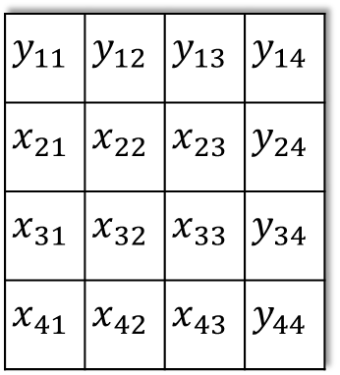

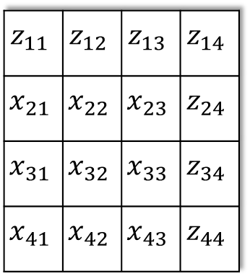


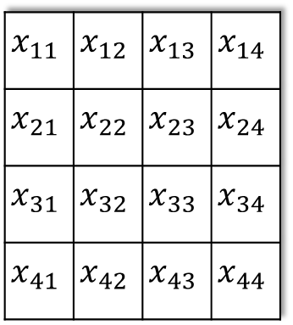
CHAPTER 1
CNN
Channel?
Input(3 channel)
Feature map of each channel
$$z_{11}$$ | $$z_{12}$$ | $$z_{13}$$ | $$z_{14}$$
$$x_{21}$$ | $$x_{22}$$ | $$x_{23}$$ | $$z_{24}$$
$$x_{31}$$ | $$x_{32}$$ | $$x_{33}$$ | $$z_{34}$$
$$x_{41}$$ | $$x_{42}$$ | $$x_{43}$$ | $$z_{44}$$
$$y_{11}$$ | $$y_{12}$$ | $$y_{13}$$ | $$y_{14}$$
$$x_{21}$$ | $$x_{22}$$ | $$x_{23}$$ | $$y_{24}$$
$$x_{31}$$ | $$x_{32}$$ | $$x_{33}$$ | $$y_{34}$$
$$x_{41}$$ | $$x_{42}$$ | $$x_{43}$$ | $$y_{44}$$
filter(3 channel)
$$x_{11}$$ | $$x_{12}$$ | $$x_{13}$$ | $$x_{14}$$
$$x_{21}$$ | $$x_{22}$$ | $$x_{23}$$ | $$x_{24}$$
$$x_{31}$$ | $$x_{32}$$ | $$x_{33}$$ | $$x_{34}$$
$$x_{41}$$ | $$x_{42}$$ | $$x_{43}$$ | $$x_{44}$$
$$⨂$$
$$+$$
Feature map
→
$$+$$

Slide 12
CHAPTER 2
Task
Text 분석을 통해 청원 인원 1000명 up, down예측
1000명을 넘는 청원, 넘지 않는 청원을 class 로 생각
각 class를 결정하는 Text의 어떠한 패턴이 있을 것
비슷한 의미를 갖는 embedding vector의 패턴 인식

Slide 13
CHAPTER 3
TextCNN
TextCNN?
Filter가 문장을 스캔하며 문맥적 의미 파악
Word embedding
Feature Map 생성
Max Pooling
Classification
장점
문장의 문맥적 의미를 파악하는 과정에서 정보를 집약 → 연산 속도 ↑
분류 문제에서 RNN보다 좋은 성능

Slide 14
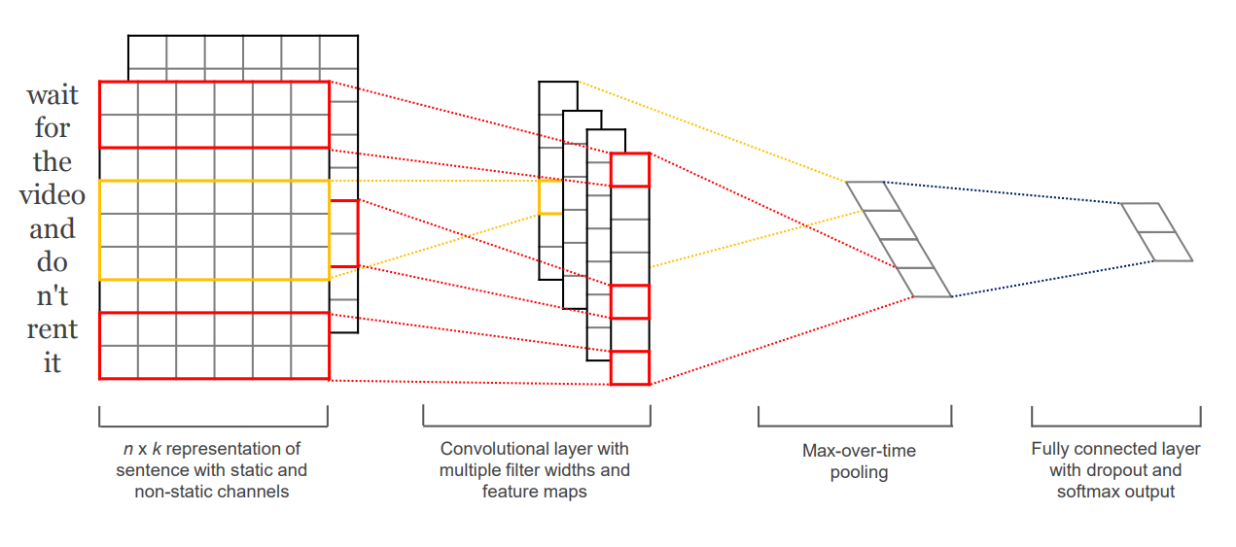
CHAPTER 3
TextCNN
TextCNN architecture
[Y. Kim] Convolutional Neural Networks for Sentence Classification (2014)

Slide 15
CHAPTER 3
TextCNN
TextCNN architecture
[Y. Kim] Convolutional Neural Networks for Sentence Classification (2014)

Slide 16
CHAPTER 3
TextCNN
TextCNN architecture
[Y. Kim] Convolutional Neural Networks for Sentence Classification (2014)

Slide 17
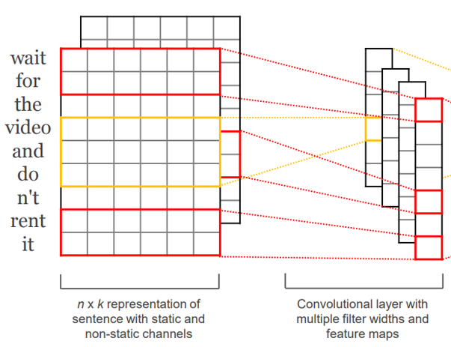
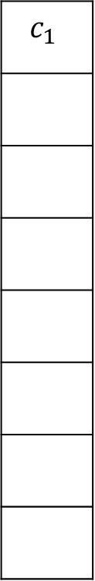
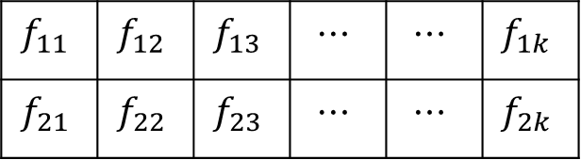
CHAPTER 3
TextCNN
TextCNN architecture
Dimension = k
Filter(window) size = 2
Feature map
wait
$$c_{1}$$
for
the
video
and
Filter size : (2, k)
do
$$f_{11}$$ | $$f_{12}$$ | $$f_{13}$$ | $$⋯$$ | $$⋯$$ | $$f_{1k}$$
$$f_{21}$$ | $$f_{22}$$ | $$f_{23}$$ | $$⋯$$ | $$⋯$$ | $$f_{2k}$$
not
rent
it

Slide 18
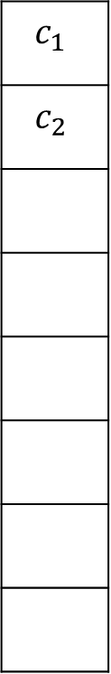
CHAPTER 3
TextCNN
TextCNN architecture
Dimension = k
Filter(window) size = 2
Feature map
wait
$$c_{1}$$
$$c_{2}$$
for
the
video
and
do
not
rent
it

Slide 19
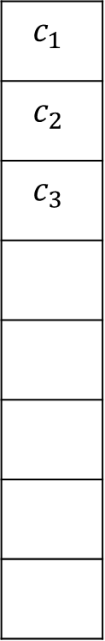
CHAPTER 3
TextCNN
TextCNN architecture
Dimension = k
Filter(window) size = 2
Feature map
wait
$$c_{1}$$
$$c_{2}$$
$$c_{3}$$
for
the
video
and
do
not
rent
it

Slide 20

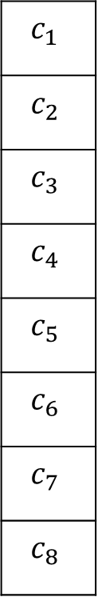
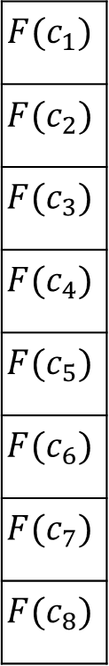
CHAPTER 3
TextCNN
TextCNN architecture
Dimension = k
Filter(window) size = 2
Feature map
activation map
wait
$$c_{1}$$
$$c_{2}$$
$$c_{3}$$
$$c_{4}$$
$$c_{5}$$
$$c_{6}$$
$$c_{7}$$
$$c_{8}$$
$$F(c_{1})$$
$$F(c_{2})$$
$$F(c_{3})$$
$$F(c_{4})$$
$$F(c_{5})$$
$$F(c_{6})$$
$$F(c_{7})$$
$$F(c_{8})$$
for
the
video
$$F$$
and
do
not
rent
it

Slide 21
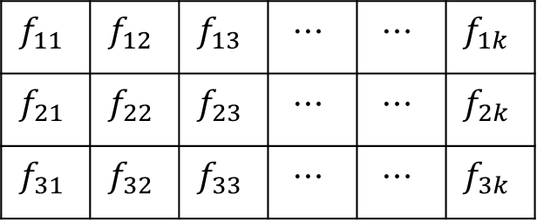
CHAPTER 3
TextCNN
TextCNN architecture
Dimension = k
Filter(window) size = 3
Feature map
wait
$$c_{1}$$
for
the
video
and
Filter size : (3, k)
do
$$f_{11}$$ | $$f_{12}$$ | $$f_{13}$$ | $$⋯$$ | $$⋯$$ | $$f_{1k}$$
$$f_{21}$$ | $$f_{22}$$ | $$f_{23}$$ | $$⋯$$ | $$⋯$$ | $$f_{2k}$$
$$f_{31}$$ | $$f_{32}$$ | $$f_{33}$$ | $$⋯$$ | $$⋯$$ | $$f_{3k}$$
not
rent
it

Slide 22
CHAPTER 3
TextCNN
TextCNN architecture
Dimension = k
Filter(window) size = 3
Feature map
wait
$$c_{1}$$
$$c_{2}$$
for
the
video
and
do
not
rent
it

Slide 23

CHAPTER 3
TextCNN
TextCNN architecture
Dimension = k
Filter(window) size = 3
Feature map
activation map
wait
$$c_{1}$$
$$c_{2}$$
$$c_{3}$$
$$c_{4}$$
$$c_{5}$$
$$c_{6}$$
$$c_{7}$$
$$c_{8}$$
$$F(c_{1})$$
$$F(c_{2})$$
$$F(c_{3})$$
$$F(c_{4})$$
$$F(c_{5})$$
$$F(c_{6})$$
$$F(c_{7})$$
$$F(c_{8})$$
for
the
video
$$F$$
and
do
not
rent
it

Slide 24
CHAPTER 3
TextCNN
TextCNN architecture
[Y. Kim] Convolutional Neural Networks for Sentence Classification (2014)

Slide 25
CHAPTER 3
TextCNN
TextCNN architecture
[Y. Kim] Convolutional Neural Networks for Sentence Classification (2014)

Slide 26
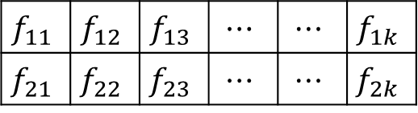
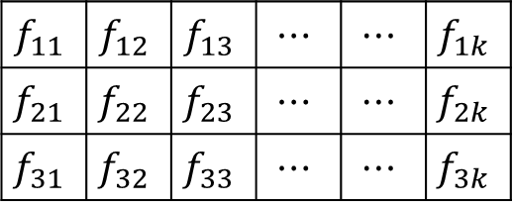
CHAPTER 3
TextCNN
activation map
TextCNN architecture
0.4
0.1
0.15
0.93
0.11
0.3
0.14
0.1
Dimension = k
Filter
wait
$$f_{11}$$ | $$f_{12}$$ | $$f_{13}$$ | $$⋯$$ | $$⋯$$ | $$f_{1k}$$
$$f_{21}$$ | $$f_{22}$$ | $$f_{23}$$ | $$⋯$$ | $$⋯$$ | $$f_{2k}$$
for
0.93
the
video
and
0.1
0.2
0.15
0.3
0.41
0.2
0.89
0.2
do
not
$$f_{11}$$ | $$f_{12}$$ | $$f_{13}$$ | $$⋯$$ | $$⋯$$ | $$f_{1k}$$
$$f_{21}$$ | $$f_{22}$$ | $$f_{23}$$ | $$⋯$$ | $$⋯$$ | $$f_{2k}$$
$$f_{31}$$ | $$f_{32}$$ | $$f_{33}$$ | $$⋯$$ | $$⋯$$ | $$f_{3k}$$
0.89
rent
it

Slide 27
CHAPTER 3
TextCNN
TextCNN architecture
[Y. Kim] Convolutional Neural Networks for Sentence Classification (2014)

Slide 28


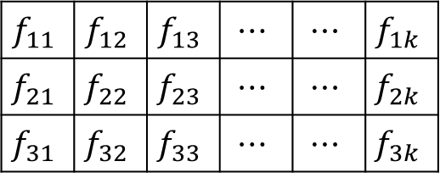



CHAPTER 3
TextCNN
TextCNN architecture
activation map
Filter
$$f_{11}$$ | $$f_{12}$$ | $$f_{13}$$ | $$⋯$$ | $$⋯$$ | $$f_{1k}$$
$$f_{21}$$ | $$f_{22}$$ | $$f_{23}$$ | $$⋯$$ | $$⋯$$ | $$f_{2k}$$
Class1
$$⋮$$
$$⋮$$
$$⋮$$
$$⋮$$
Class2
$$f_{11}$$ | $$f_{12}$$ | $$f_{13}$$ | $$⋯$$ | $$⋯$$ | $$f_{1k}$$
$$f_{21}$$ | $$f_{22}$$ | $$f_{23}$$ | $$⋯$$ | $$⋯$$ | $$f_{2k}$$
$$f_{31}$$ | $$f_{32}$$ | $$f_{33}$$ | $$⋯$$ | $$⋯$$ | $$f_{3k}$$

Slide 29
CHAPTER 3
TextCNN
TextCNN architecture in our Model
Embedding dimension : 100차원
Filter size = 3, 4, 5
Filter channel = 10
Number of class = 2 (Yes, No)
Activation function = ReLU
Max Pooling
Dropout = 40%
Optimizer = Adam
Epoch = 3

Slide 30


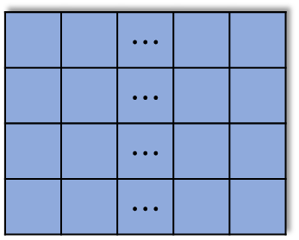
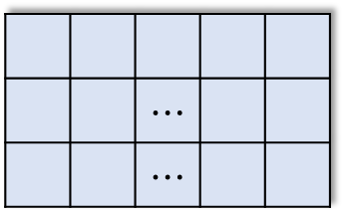



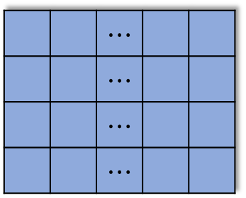

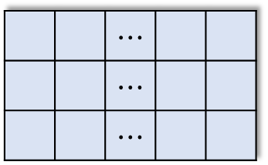
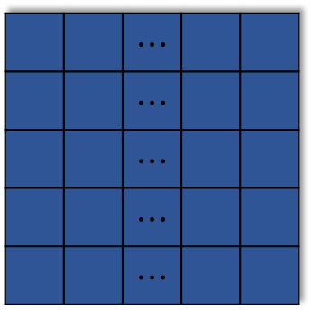


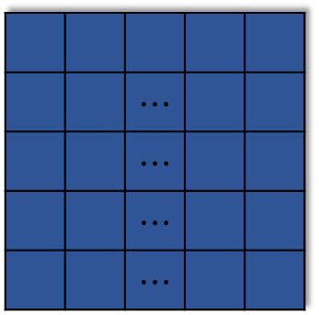



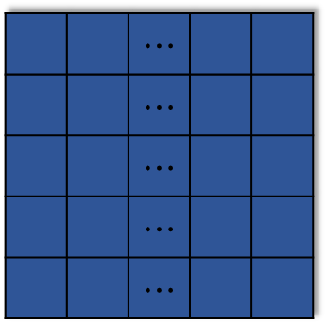
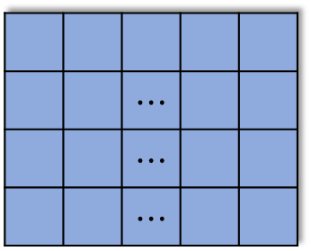



CHAPTER 3
TextCNN
TextCNN architecture in our Model
input
Filter
Feature Map
Activation Map
Max-pooling
Fully Connetcted
Softmax
.
.
51x1
51x1
.
 |  | $$⋯$$
 |  | $$⋯$$
 |  | $$⋯$$
 |  | $$⋯$$
 |  | $$⋯$$
 |  | $$⋯$$
 |  | $$⋯$$
 |  | $$⋯$$
.
.
.
.
$$⨂$$
.
.
$$F$$
$$⋮$$
Dimension = 100
.
$$⋮$$
.
.
 |  | $$⋯$$
 |  | $$⋯$$
 |  | $$⋯$$
50x1
50x1
 |  | $$⋯$$
 |  | $$⋯$$
$$⋮$$ | $$⋮$$ |  | $$⋮$$ | $$⋮$$
 |  | $$⋯$$
 |  | $$⋯$$
 |  | $$⋯$$
 |  | $$⋯$$
 |  | $$⋯$$
 |  | $$⋯$$
Yes
No
 |  | $$⋯$$
 |  | $$⋯$$
 |  | $$⋯$$
 |  | $$⋯$$
$$⨂$$
.
.
.
.
.
.
$$F$$
$$⋮$$
$$⋮$$
.
.
.
 |  | $$⋯$$
 |  | $$⋯$$
 |  | $$⋯$$
 |  | $$⋯$$
 |  | $$⋯$$
 |  | $$⋯$$
 |  | $$⋯$$
 |  | $$⋯$$
 |  | $$⋯$$
49x1
49x1
$$⋮$$
 |  | $$⋯$$
 |  | $$⋯$$
 |  | $$⋯$$
 |  | $$⋯$$
 |  | $$⋯$$
.
.
.
.
$$⨂$$
.
.
$$F$$
$$⋮$$

Slide 31
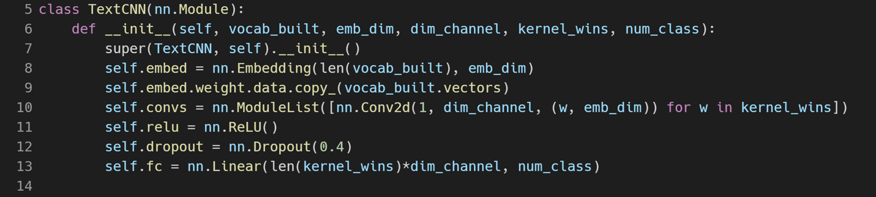


CHAPTER 4
CODE
TextCNN 모델링
Feature Map
Activation Map
.
.
.
.
.
.
$$F$$
10
$$⋮$$

Slide 32
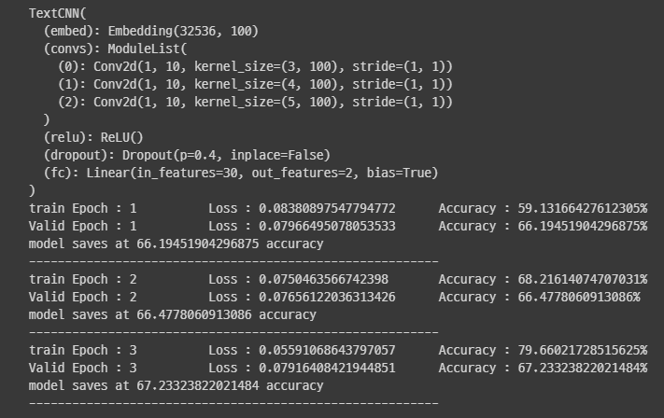
CHAPTER 4
CODE
결과

Slide 33
Q&A
2021. 11. 03
Min Jun Kim

Slide 34
THANK YOU.
2021. 11. 03
Min Jun Kim

